Slide 1
Macro Outlook
2024

Slide 2
Bullish Points

Slide 3
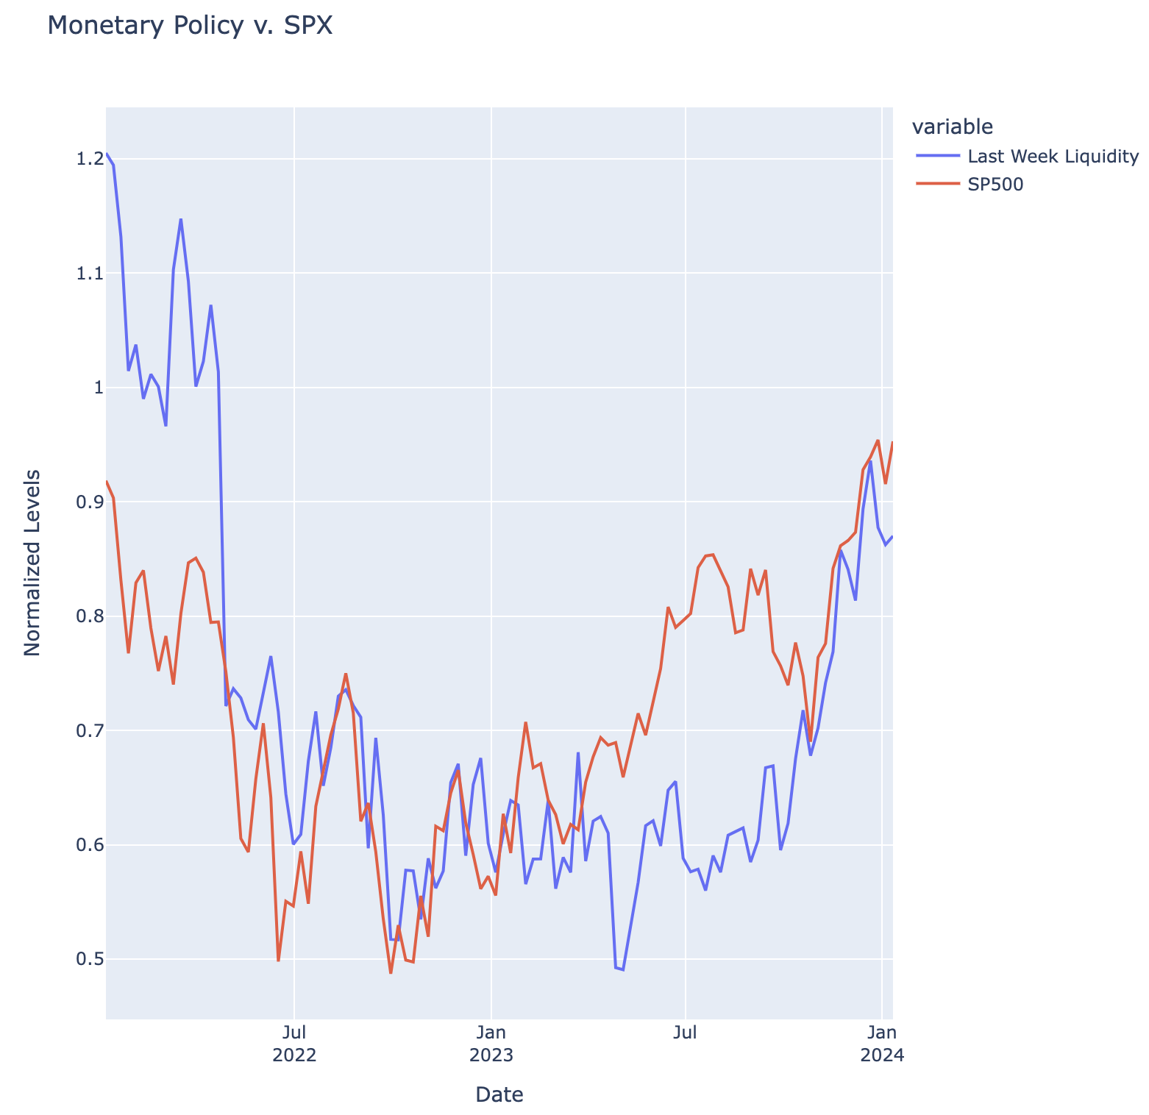
Fed Policy
Election Year: Fed is more politicized now
Ever since 2022, SPX has tracked the Fed Balance Sheet very closely (Correlation: 0.78)
Last Week Liquidity = SOMA – TGA – RRP
Shifted one week
Subtract TGA because treasury spending adds liquidity to the market
Built up TGA and fast diminishing RRP

Slide 4
Core CPI and Unemployment: Fed Rate Cuts
Can see why the markets are pricing in rate cuts starting at the beginning of March
These are all the times where Fed started to cut rates
Green Text: Where we were most recently
Just under 4.0% for CORE CPI
Low Unemployment (3.7%)

Slide 5
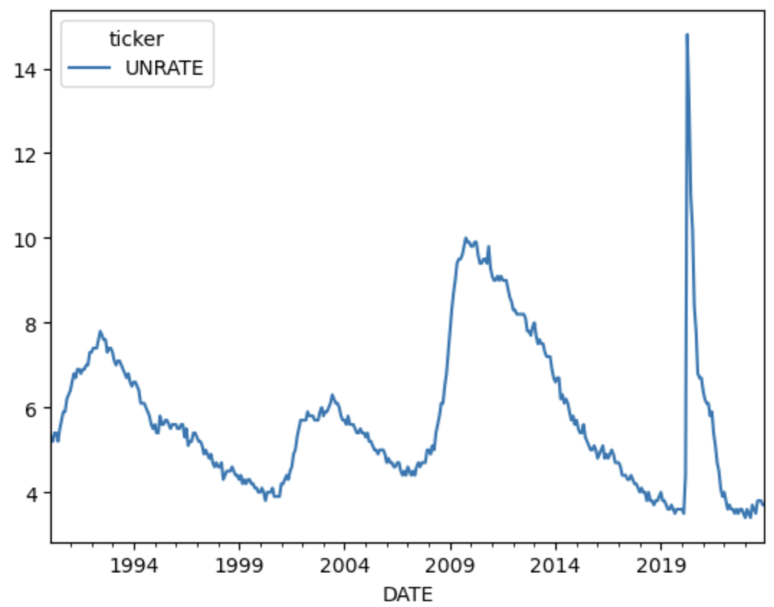
Unemployment Rate
After 525bp rate hike cycle, US unemployment rate is still below 4%
Fed Dual Mandate: Price Stability and Full Employment
Cuts in March might be priced in too early

Slide 6
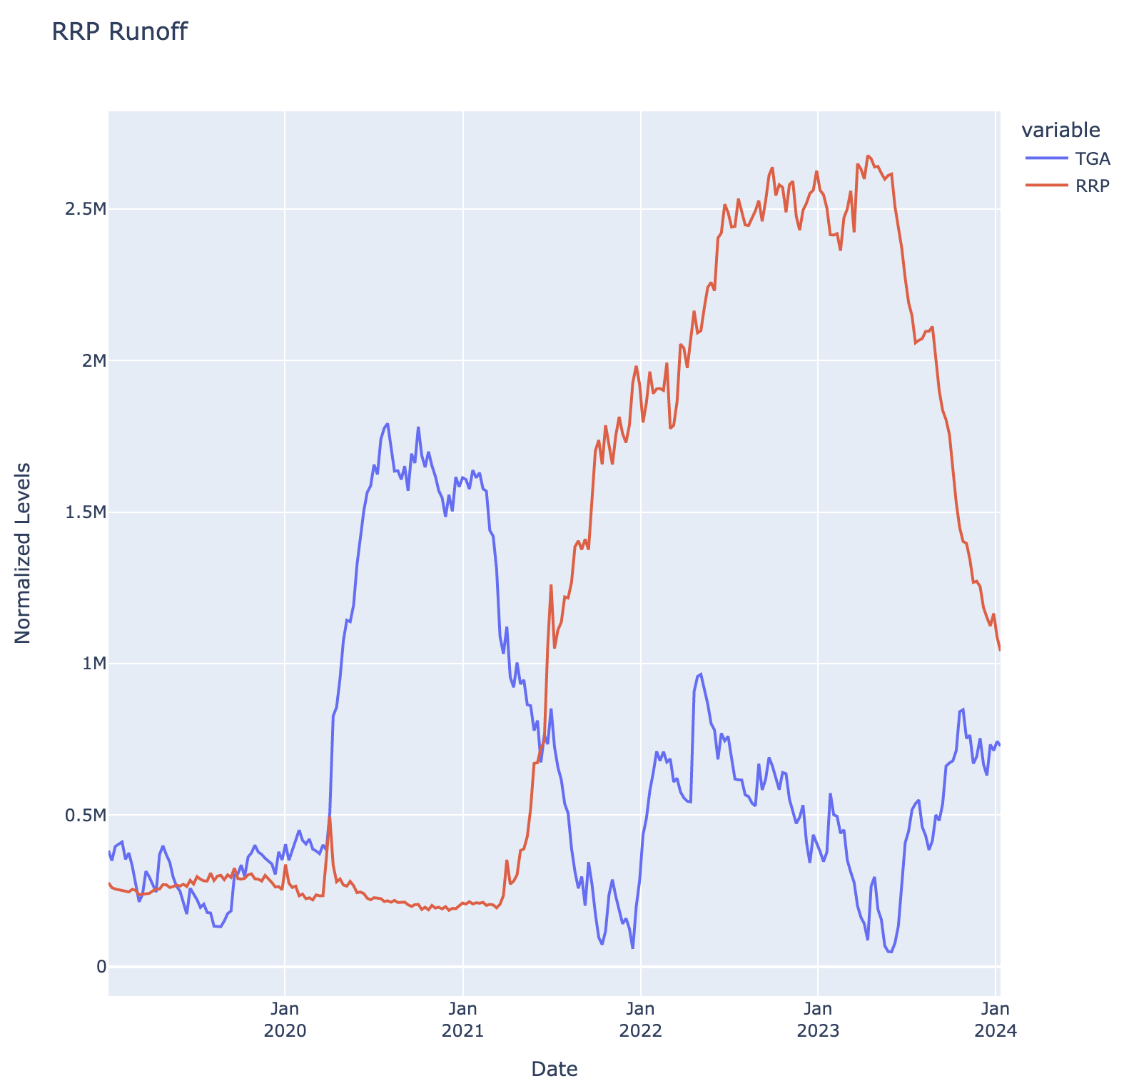
RRP
Built up TGA with fast decreasing RRP is bullish for assets
Diminishing TGA is bullish because Treasury is spending money in the economy
This adds liquidity into the market
Diminishing RRP is bullish because:
A reduction in the usage of the RRP facility could be associated with changing expectations regarding interest rates. In an environment where interest rates are expected to decline, investors might seek higher returns in riskier assets, potentially benefiting equities

Slide 7
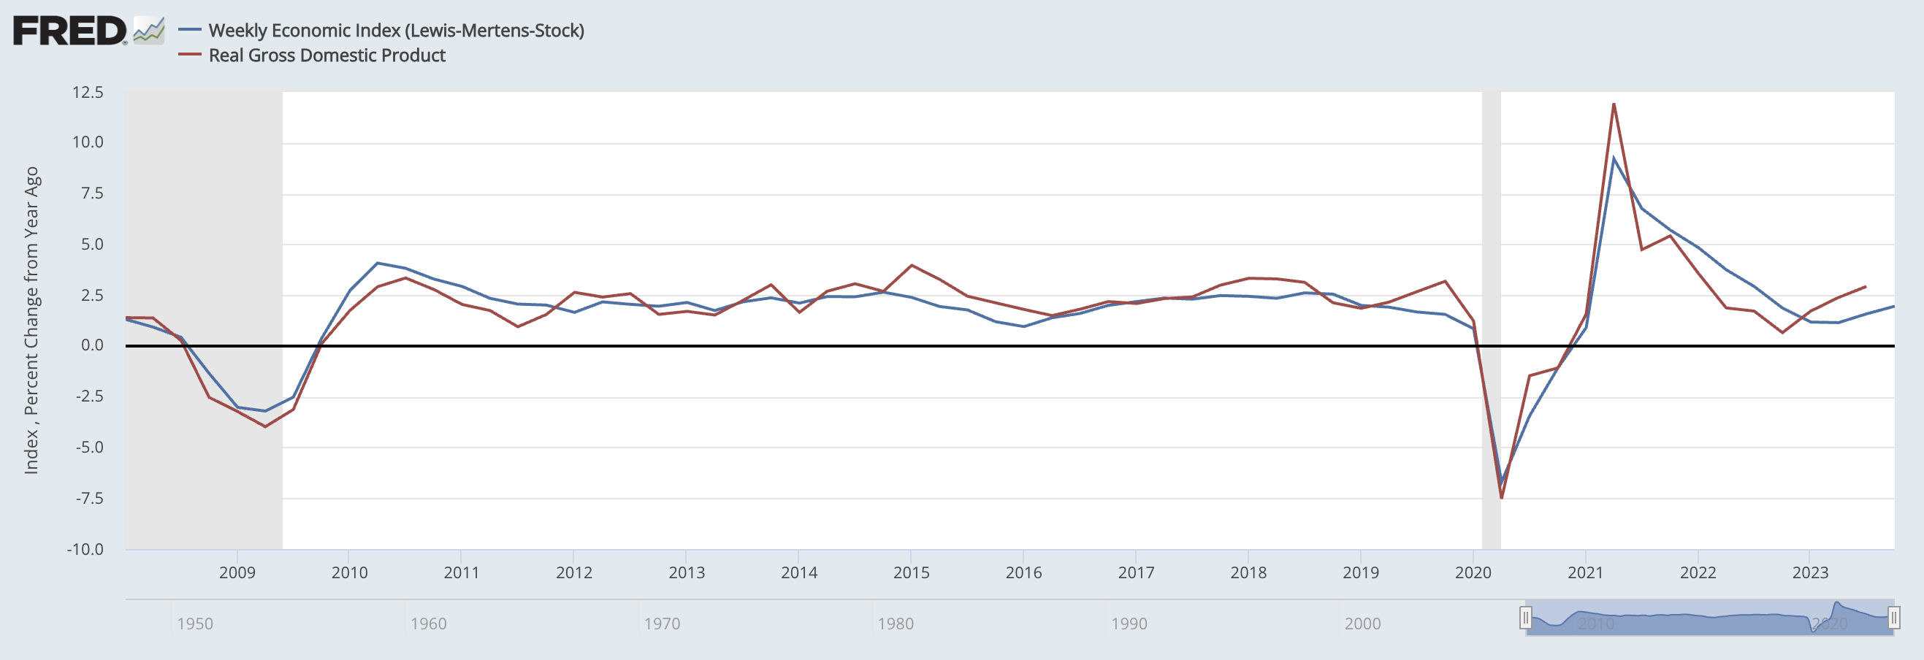
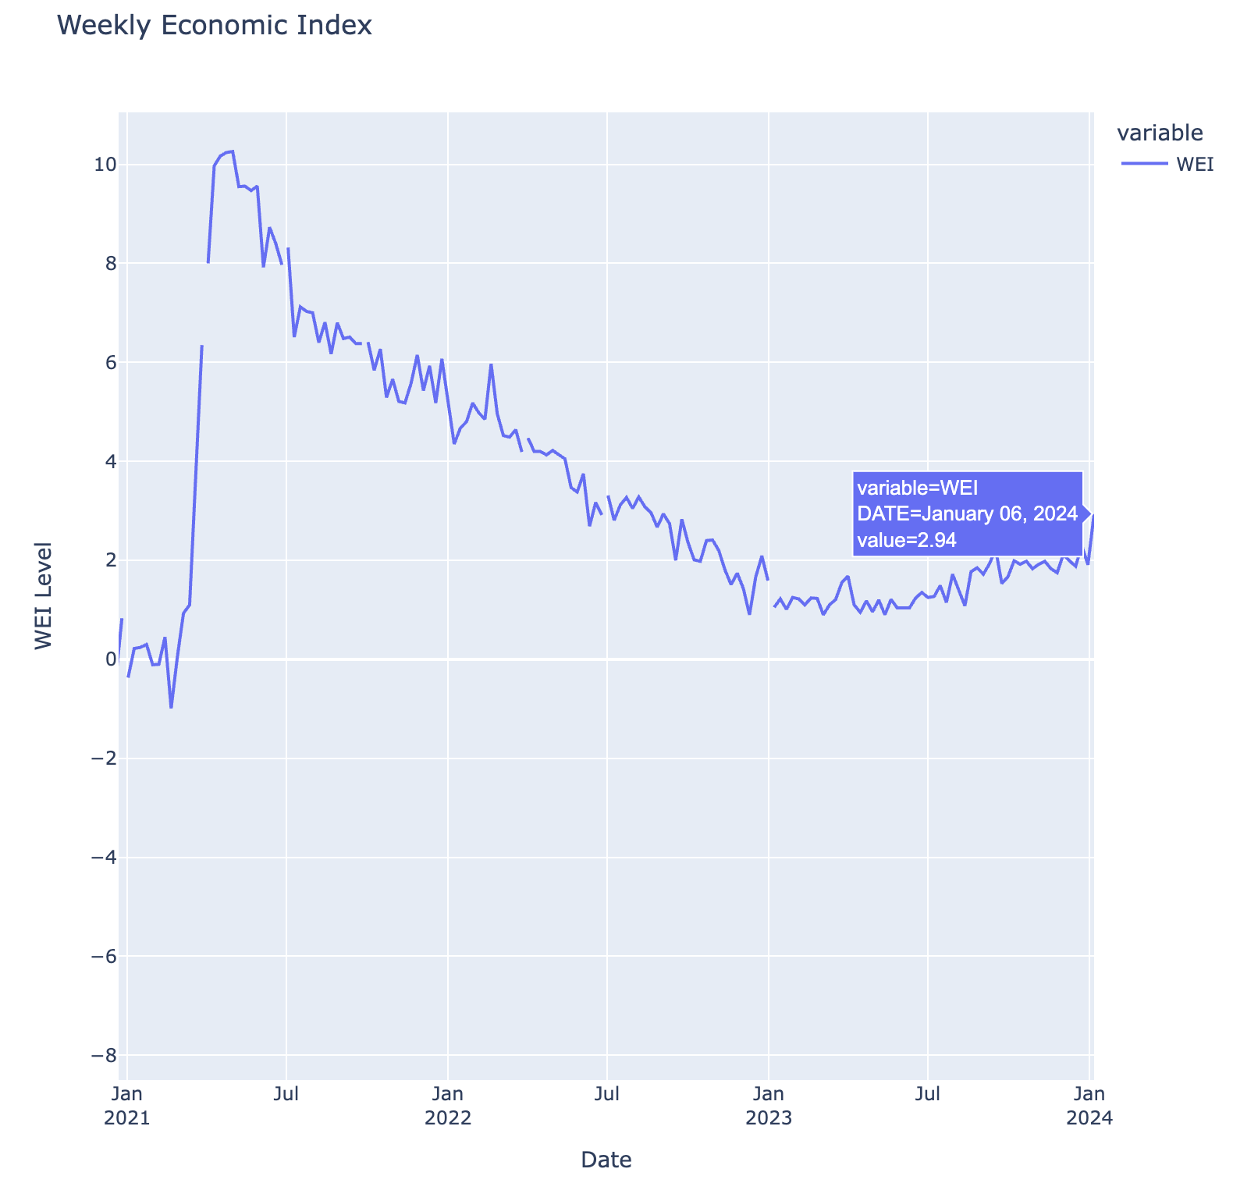
Growth – Positive Recent WEI Prints
Real GDP relationship with Weekly Economic Index
Jan 6th Level: 2.94
By this measure, the economy seems to be growing despite tighter monetary policy

Slide 8
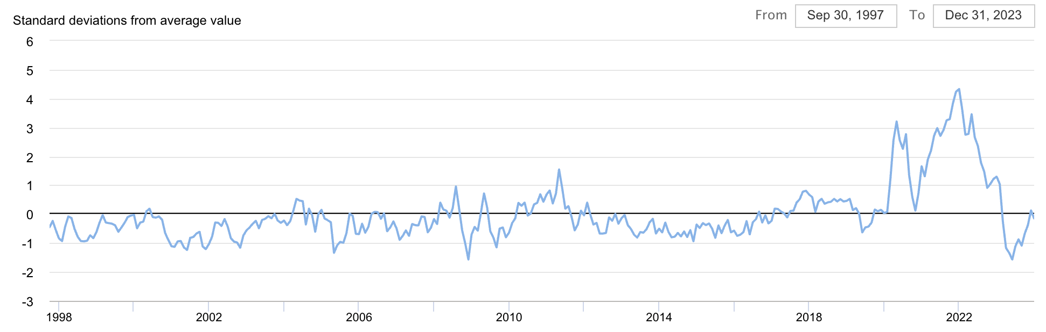
Bearish Points
Supply Chain has already normalized – Some believe that’s why that last bit in bringing down inflation won’t be as quick and easy as the market thinks

Slide 9
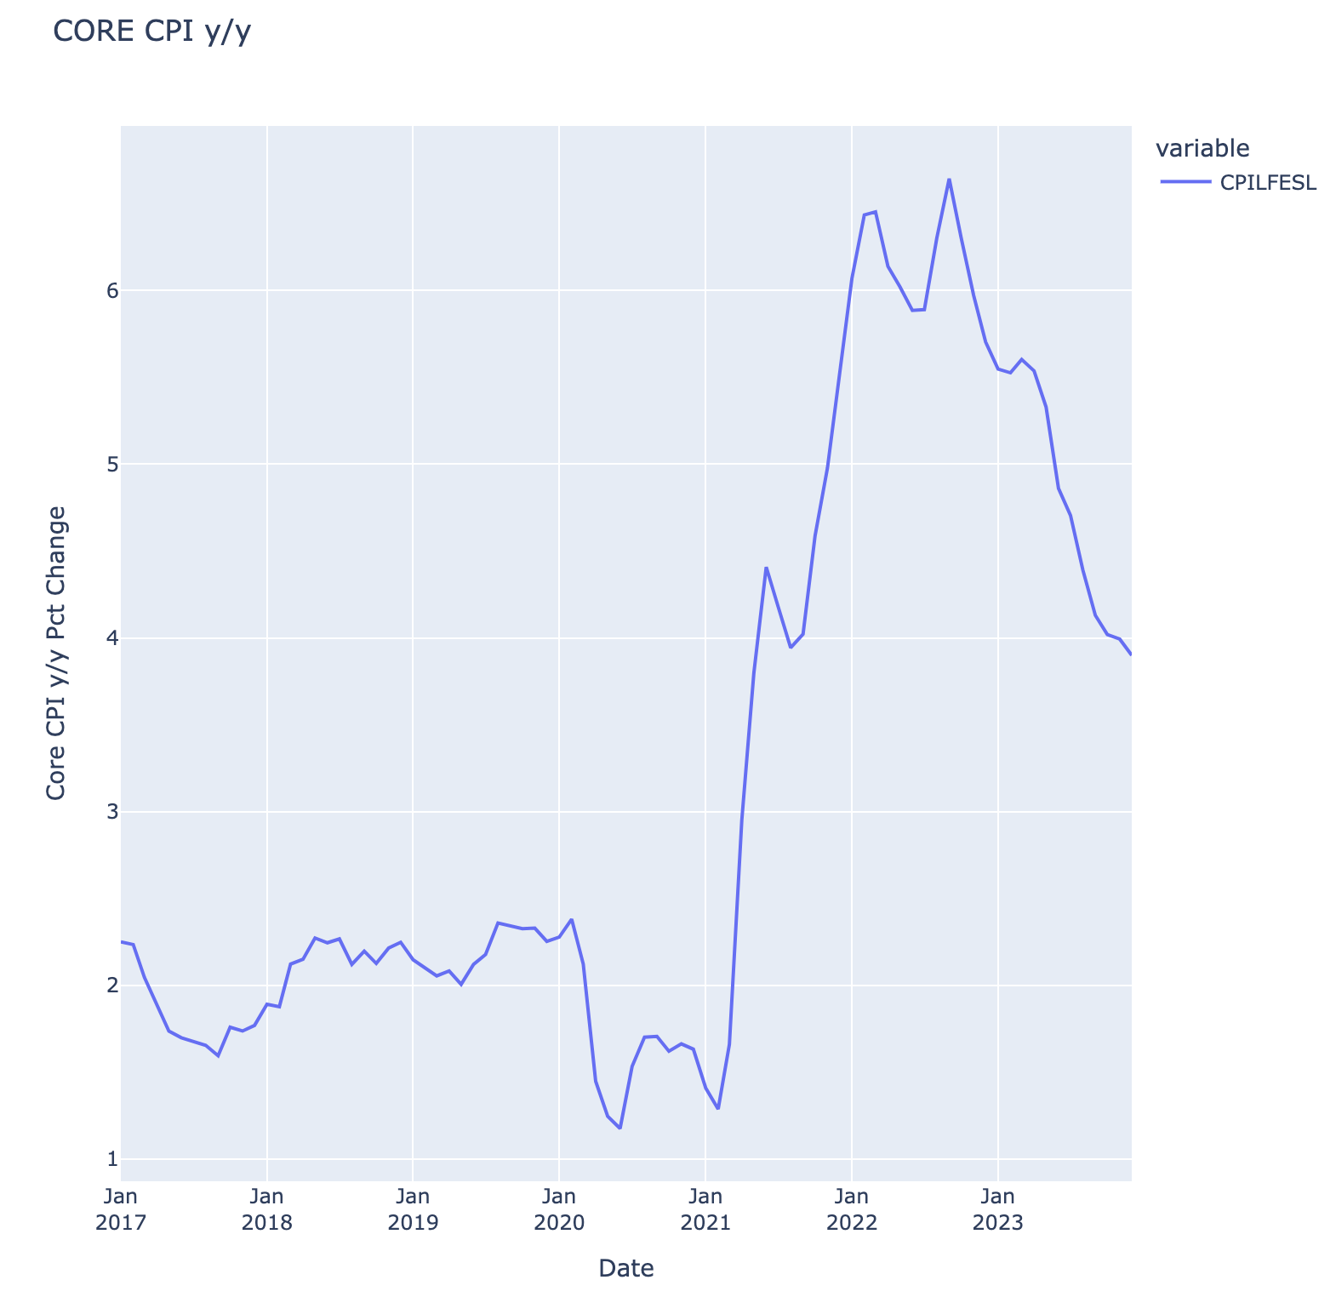
Core CPI (Market is too Dovish)
Core CPI has fallen quite significantly due to supply chain normalization and tighter monetary policy but still not close to 2%
PCE is what Fed looks at, but most recent data comes out later in the month
Consensus for PCE Number: 2.9% y/y
0.2% m/m
This number is coming down but seems to high for Fed to declare victory over inflation
Expecting rate cuts to not happen until May meeting (market is too dovish)

Slide 10
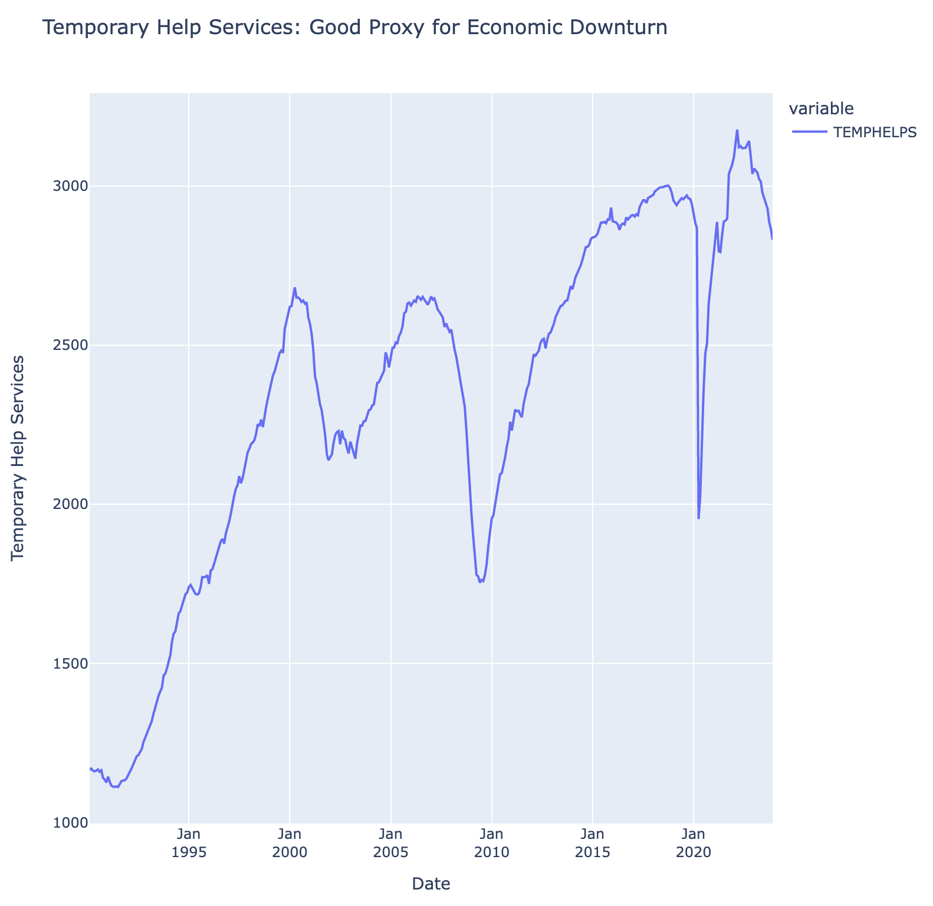
Temporary Health Services
Starts declining in each economic downturn
Leading indicator for Fed mandate of full employment

Slide 11
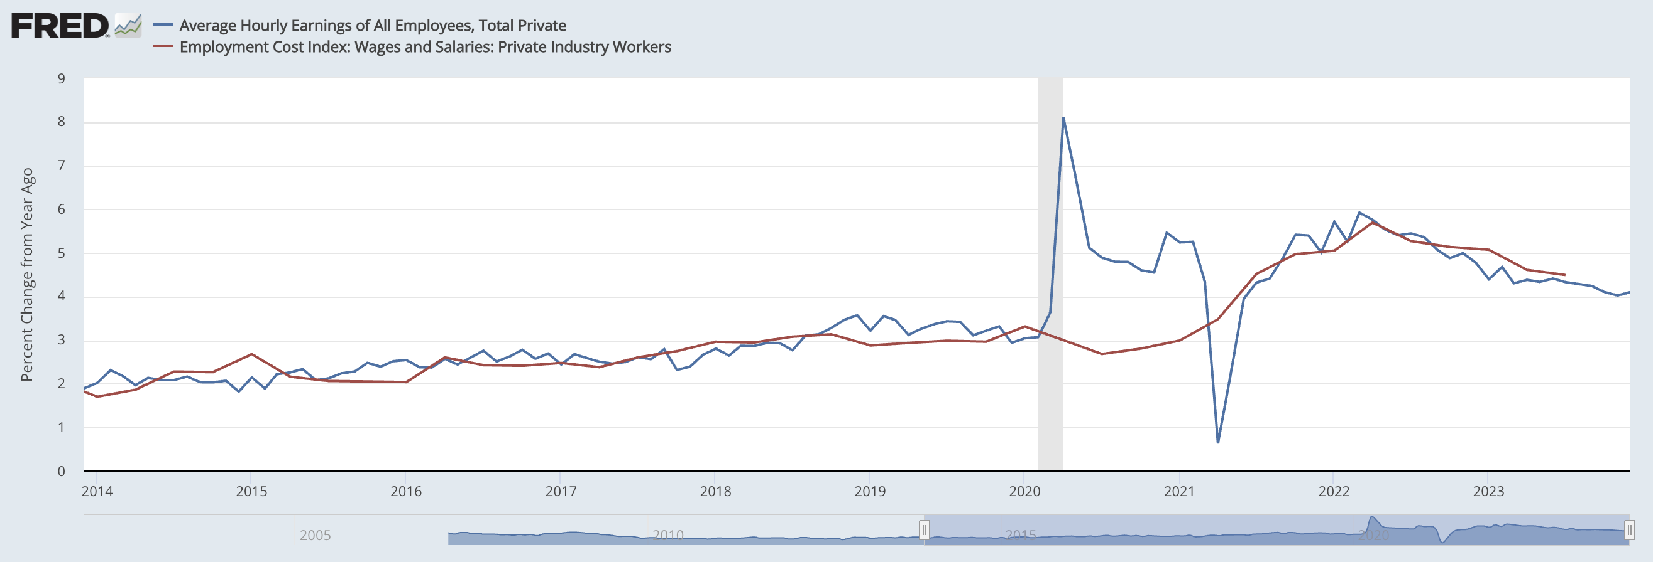
Wage Inflation
Hawkish: ECI and AHE are trending downward but still no where near where Fed has targeted for proxy for wage inflation
Wages will need to come down more to decrease consumer demand
Relevant: Fed mandate for price stability and participants might be overlooking as market priced in March rate cuts around 70% probability

Slide 12
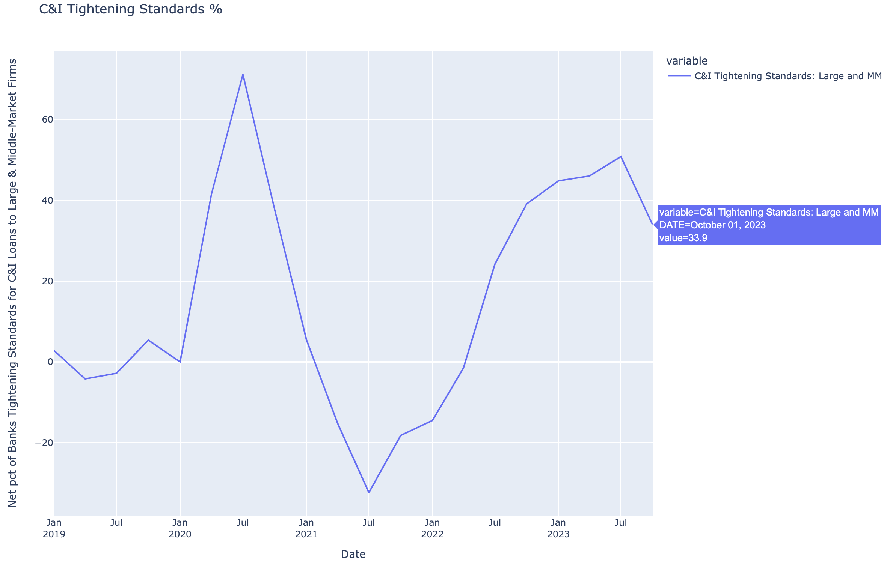
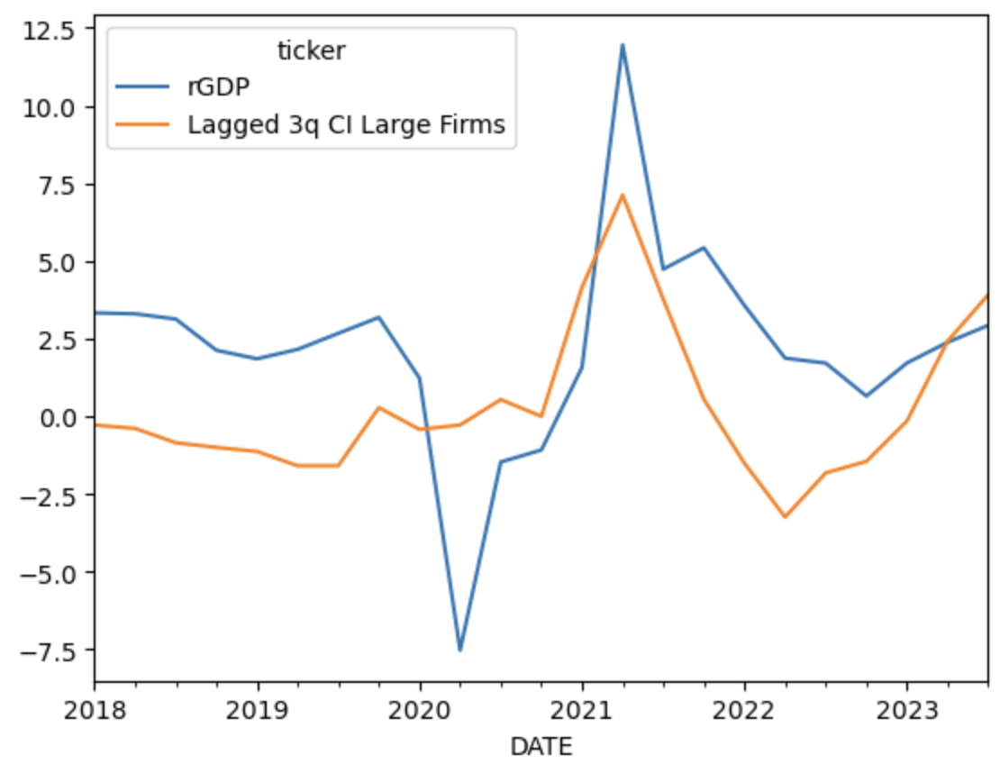
C&I Tightening Standards
Real GDP tracks 3 quarter lag of C&I Tightening Standards for Large and MM Firms.
Reaffirming consensus that Real GDP will slow 4Q23.
First (top) chart is the most recent SLOOS data
Bottom chart is lagged version of SLOOS Tightening Standard for Large and Middle Market Firms with YoY Real GDP

Slide 13
Geopolitical Risks
Geopolitical experts claiming most could be connected
Swarm Strategy implemented by China and Russia
9 months ago: Xi and Putin came out of dinner saying, “changes not seen in 100 years.”
Ongoing Russia - Ukraine
China’s tactics recently in Taiwan Strait during election
Record number of balloons deployed (13 flew directly over Taiwan)
108 aircraft and 61 warships around time of election on 13th
China violates Vietnam and Philippines EEZ
US-Philippine Drills countered by Chinese show of force
Hamas attack on Israel
Houthis in Red Sea
Crime Gang Violence in Ecuador
SMERSH – Russia reinstates Anti-Spy

Slide 14
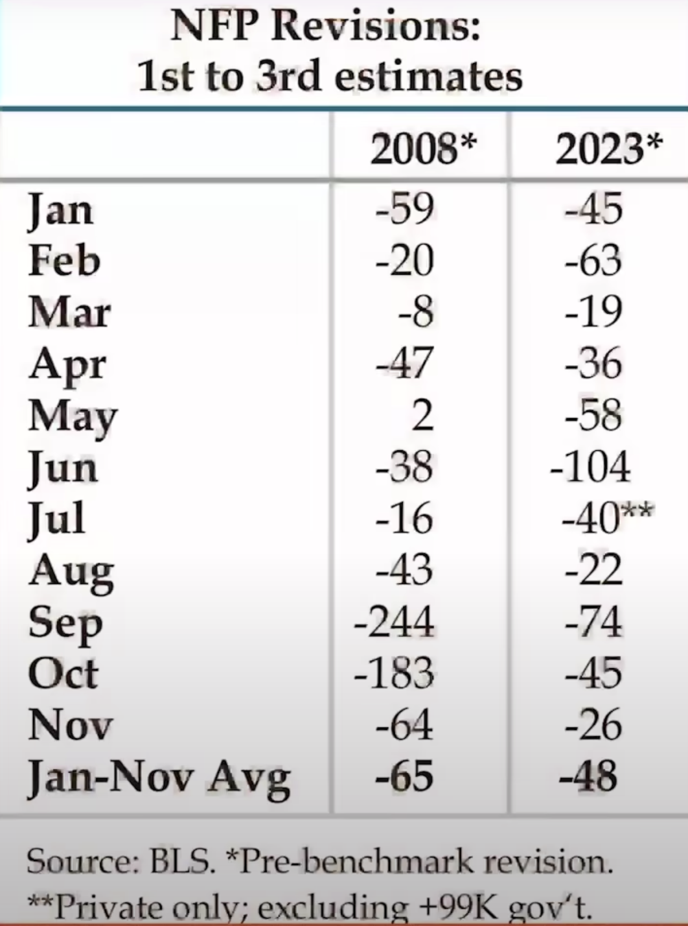
NFP Revisions
Haven’t seen so many NFP downward revisions since 2008
Credit: Danielle DiMartino Booth

Slide 15
Overweights / Underweights

Slide 16
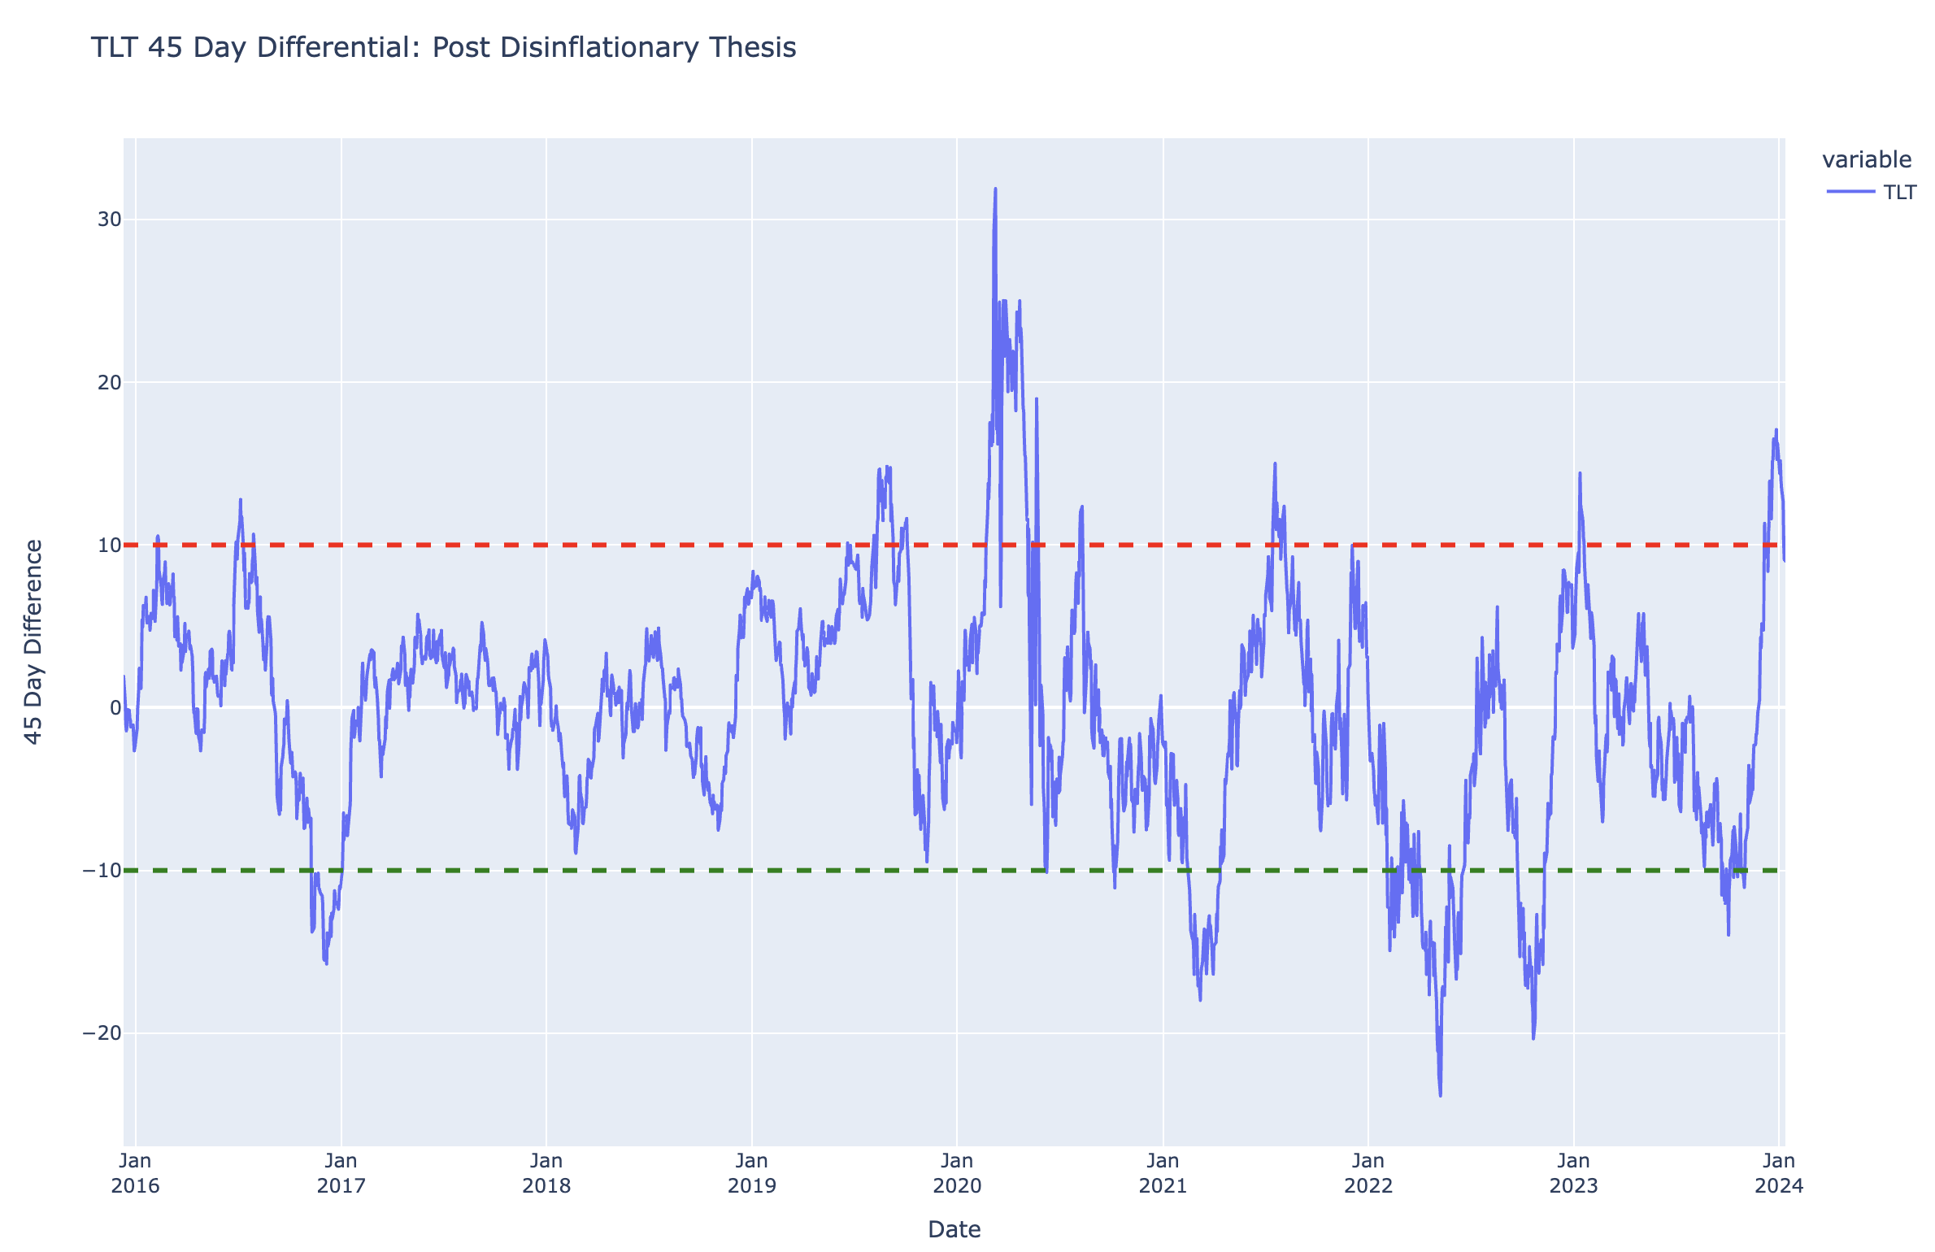
TLT (Overvalued Levels)
Rates dropped due to 6.5 price cuts priced into market starting in March
Risks are skewed toward higher rates from here
Prefer steepeners (2s10s and 5s30s)
Seems too early given the following:
Wage Inflation
Core CPI (trending down but no where near Fed target)
Tight labor market: 3.7% Unemployment
Things to look out for:
PCE (what Fed looks at): comes out later in January. Market sees this number coming down a lot. Consensus 0.2% m/m putting number at 2.8%.
Seems still quite high compared to Fed target.

Slide 17
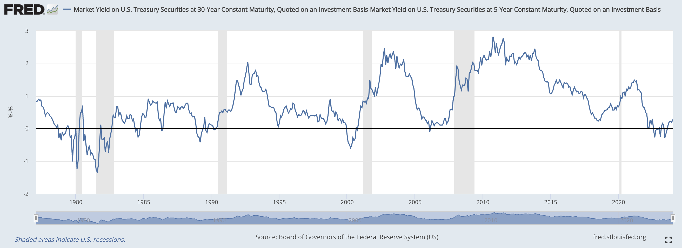
Steepeners
Buy 5s, Sell 30s
This looks like better trade than TLT
Markets already pricing excessive easing for 1H24
Increase in duration supply
Steepeners – Hedge to recessionary shocks as Fed cuts rates (6.5 priced in for 2024)
5s30s looks more attractive as more exposure to duration

Slide 18
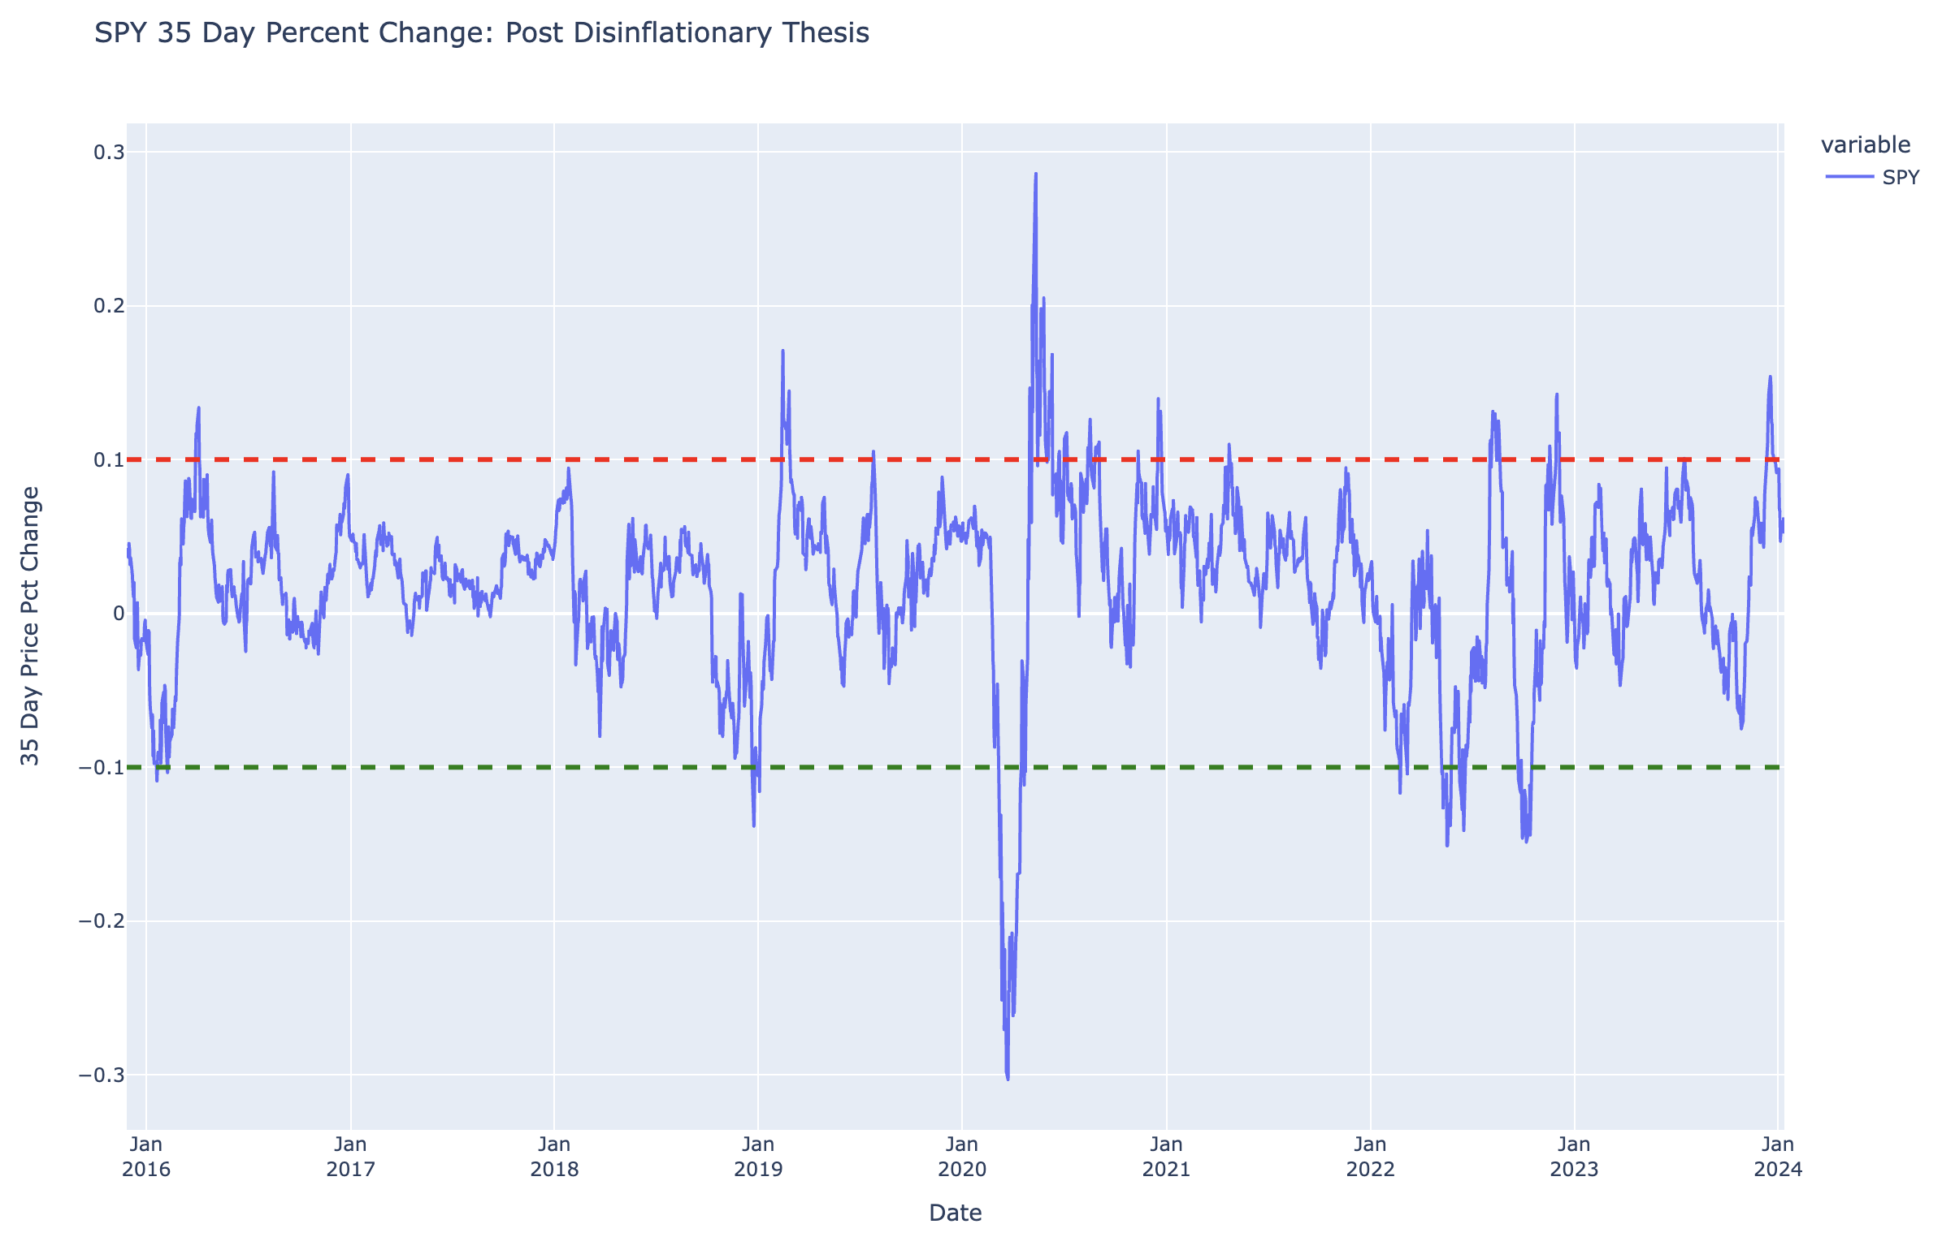
SPY (Overvalued Levels)
Disinflationary Thesis: Assets saw Santa rally in November and December of 2023 as people declared victory over inflation.
SPY seems overvalued here following optimistic market and 35-day percent change in SPY, but looks better than bonds given 6.5 rate cuts priced in already.
Cuts priced in for March are probably too early given high wages, PCE consensus still in upper 2’s,unemployment at 3.7%, and 3.9% Core CPI.
Market is too optimistic in my view and should correct. Fed has 3 cuts priced in.

Slide 19
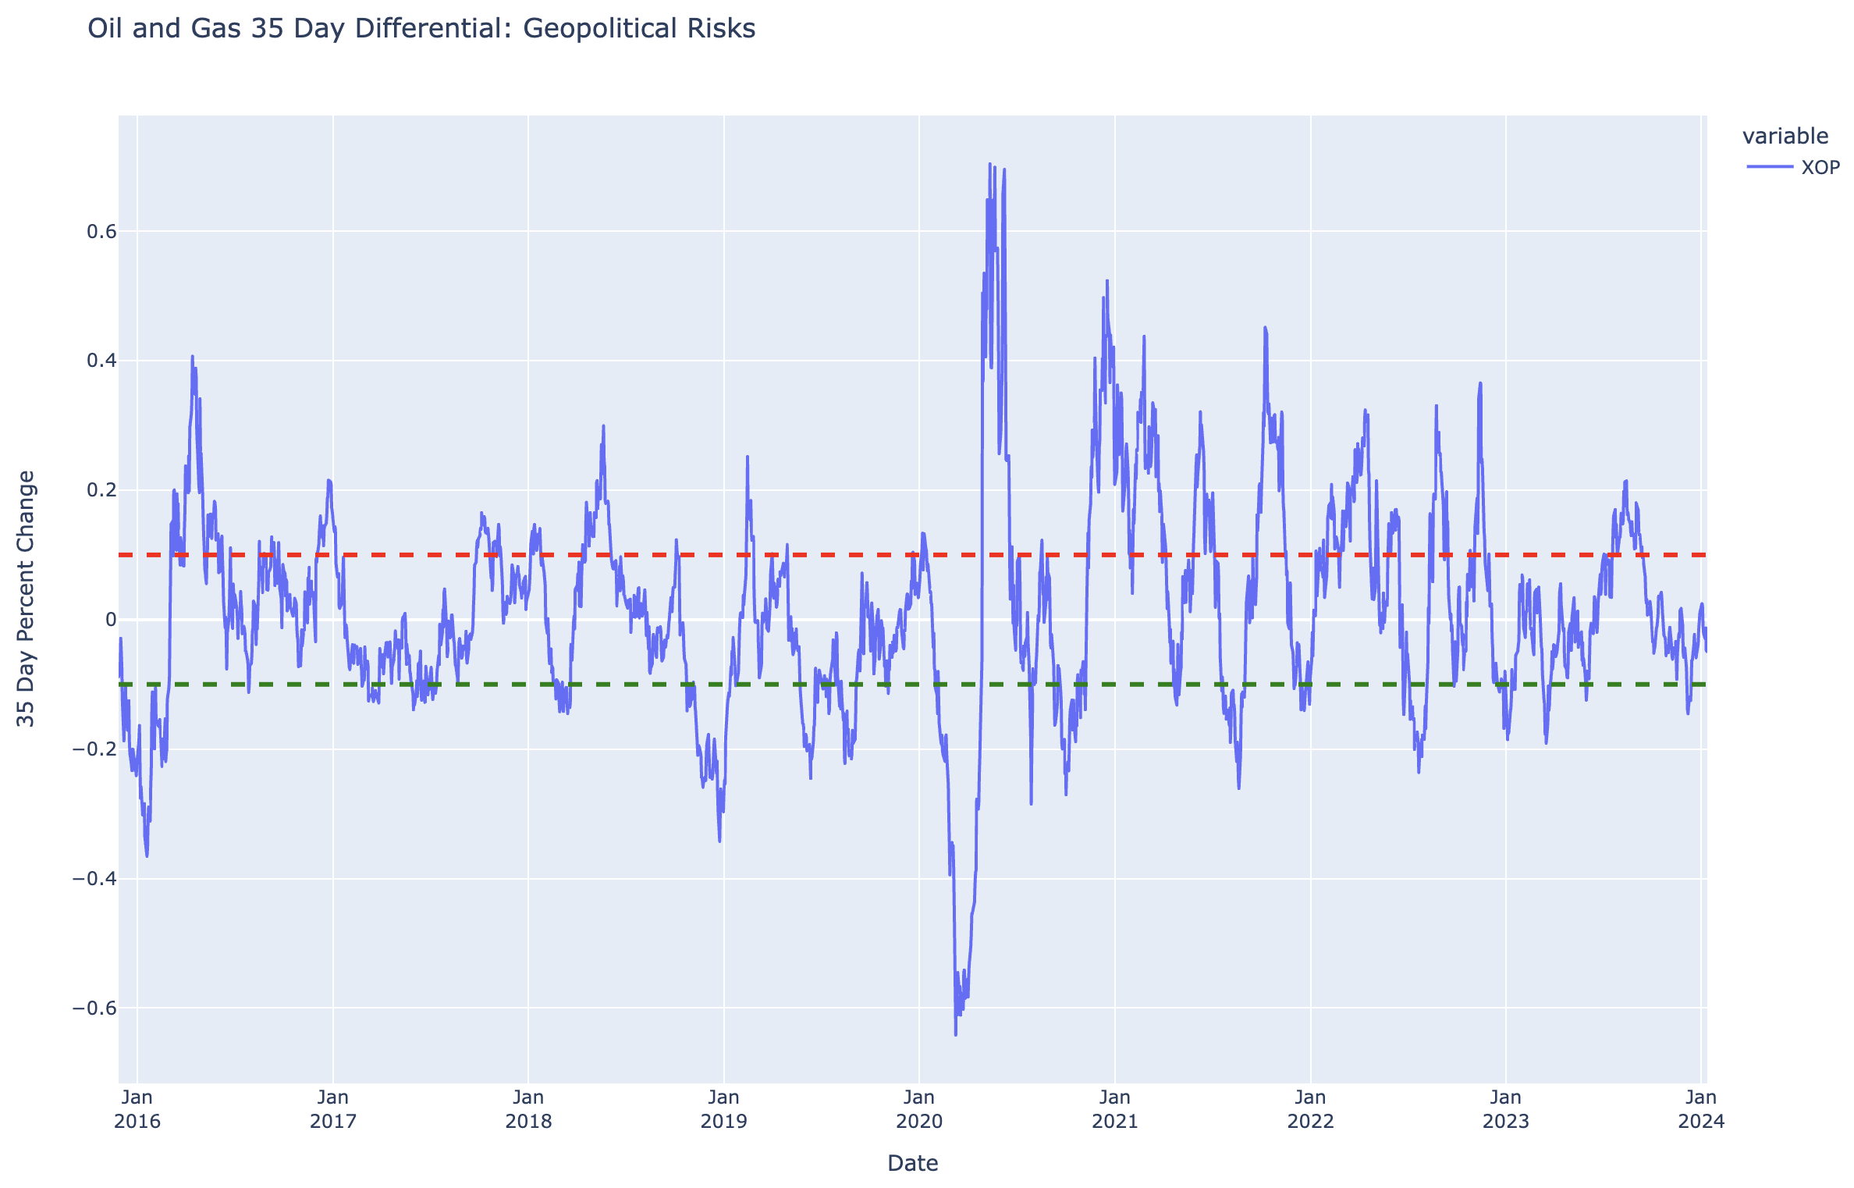
Oil and Gas (XOP)
Exposure to post-Russian energy transition
Exposure to oil companies that have great balance sheets and are huge cash flow providers.
Tends to outperform in stagflationary regimes.
Increasing YoY Headline CPI with decreasing Real GDP YoY growth
Immaculate Disinflation Thesis is most likely going to see pushback in early 2024
DPP new leader in Taiwan wants to phase out Nuclear
Bullish for natural gas

Slide 20
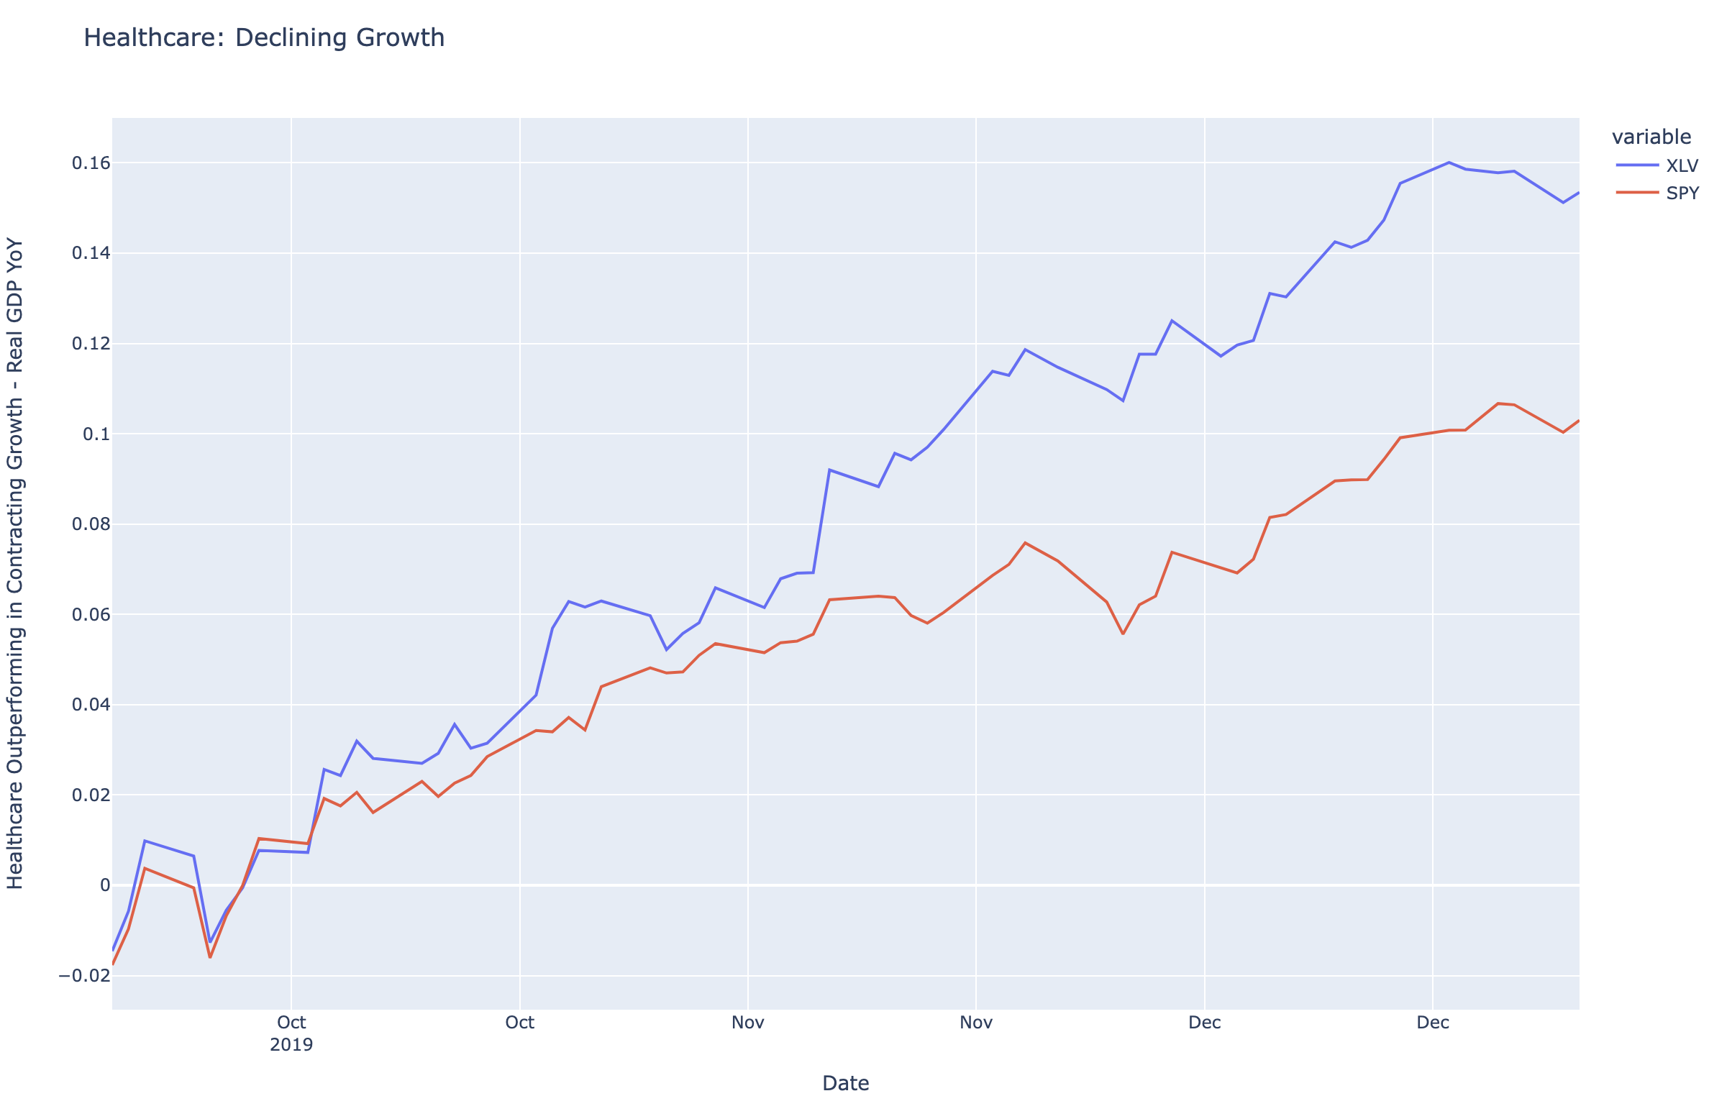
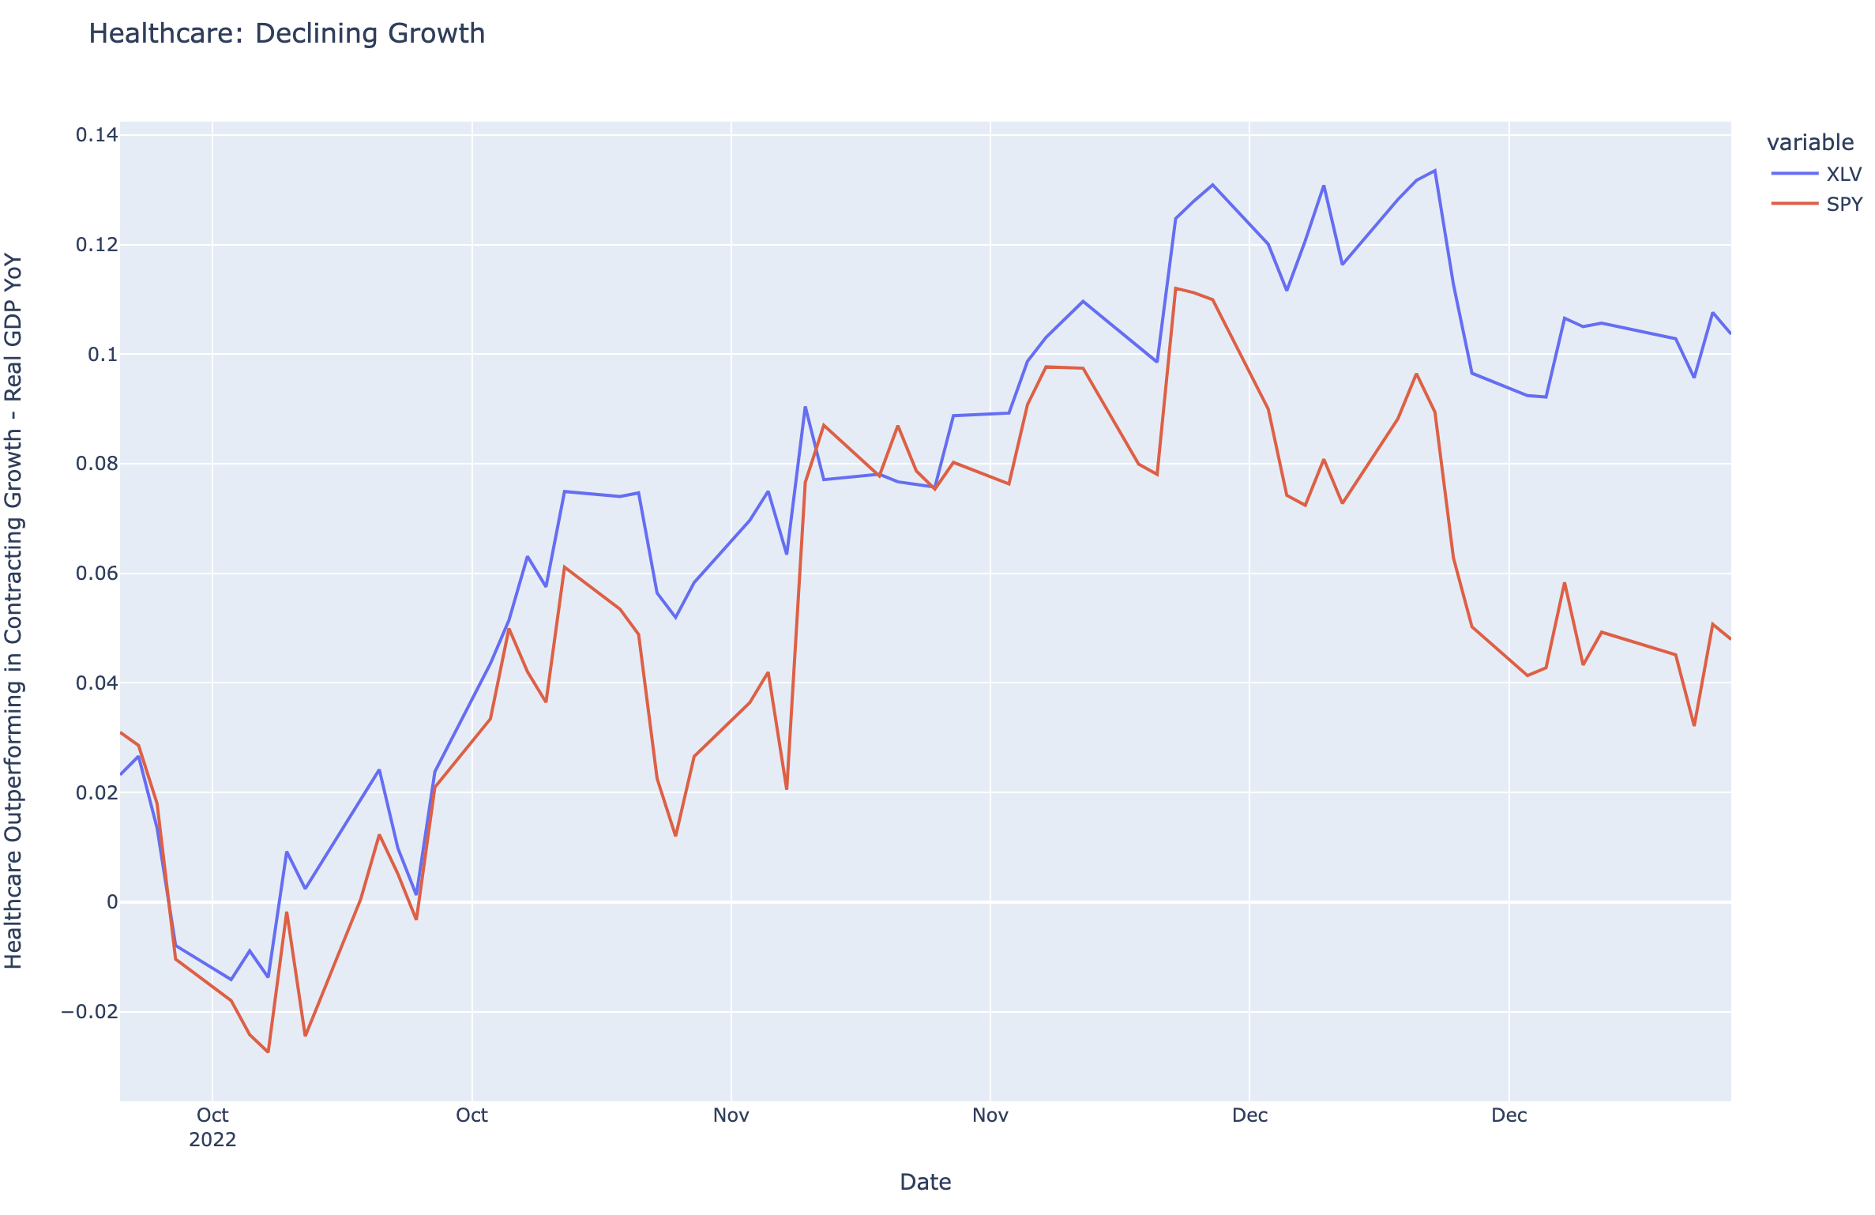
Healthcare: Declining Growth
Healthcare usually outperforms in quarters where GDP YoY contracts
2 examples are:
Q419 and Q422
Healthcare equities tend to outperform when growth (Real GDP y/y) contracts.
XLV trending but not near overvalued levels

Slide 21
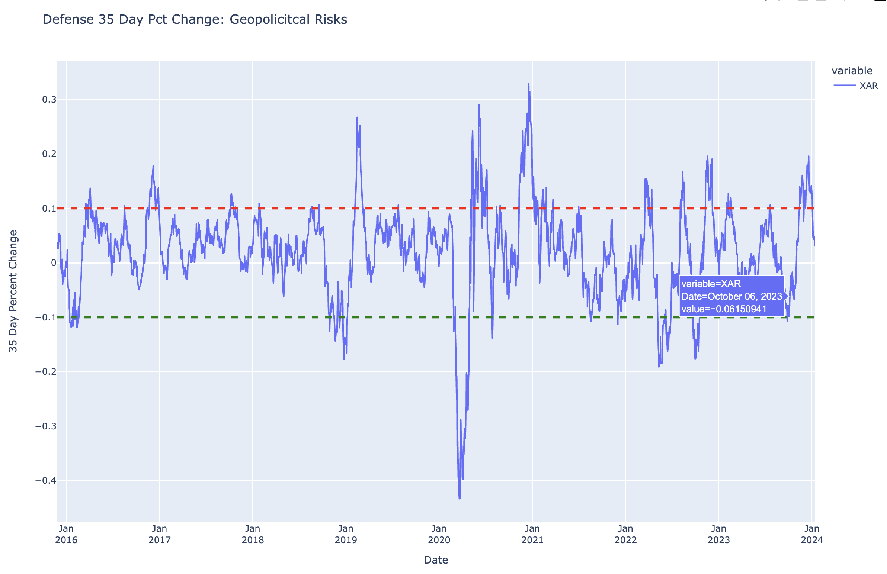
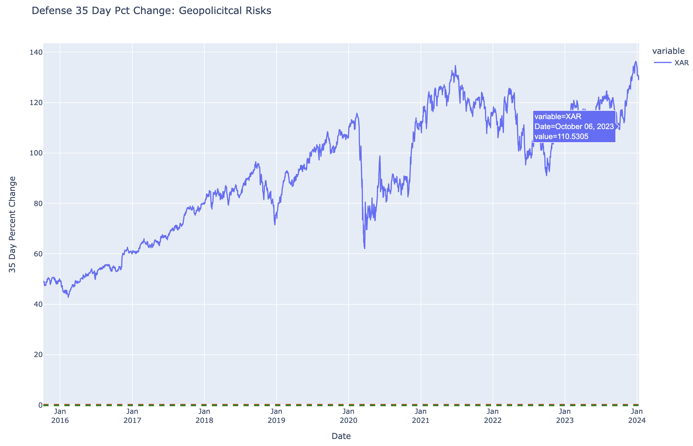
Defense Companies
XAR saw steep equity increase after October 7th attacks against ally, Israel.
Seeing heightened geopolitical risk all over the globe
Believe geopolitical risks will remain heightened, especially in Middle East
Also touched on HII (due to AUKUS and South China Sea)
See HII Code and Results (Factors):
https://github.com/RyanFineganTradingProjects/2023-11-27-Trades/blob/main/QD%20Trading%20Strat%20HII.ipynb
See HII PDF:
https://github.com/RyanFineganTradingProjects/2023-11-27-Trades/blob/main/HII%20Long.pdf
(fundamental and systematic points) - quality name that has tailwinds suggesting Fed demand for larger, more modern fleet. (AUKUS, troubles in South China Sea, and Red Sea conflicts)

Slide 22
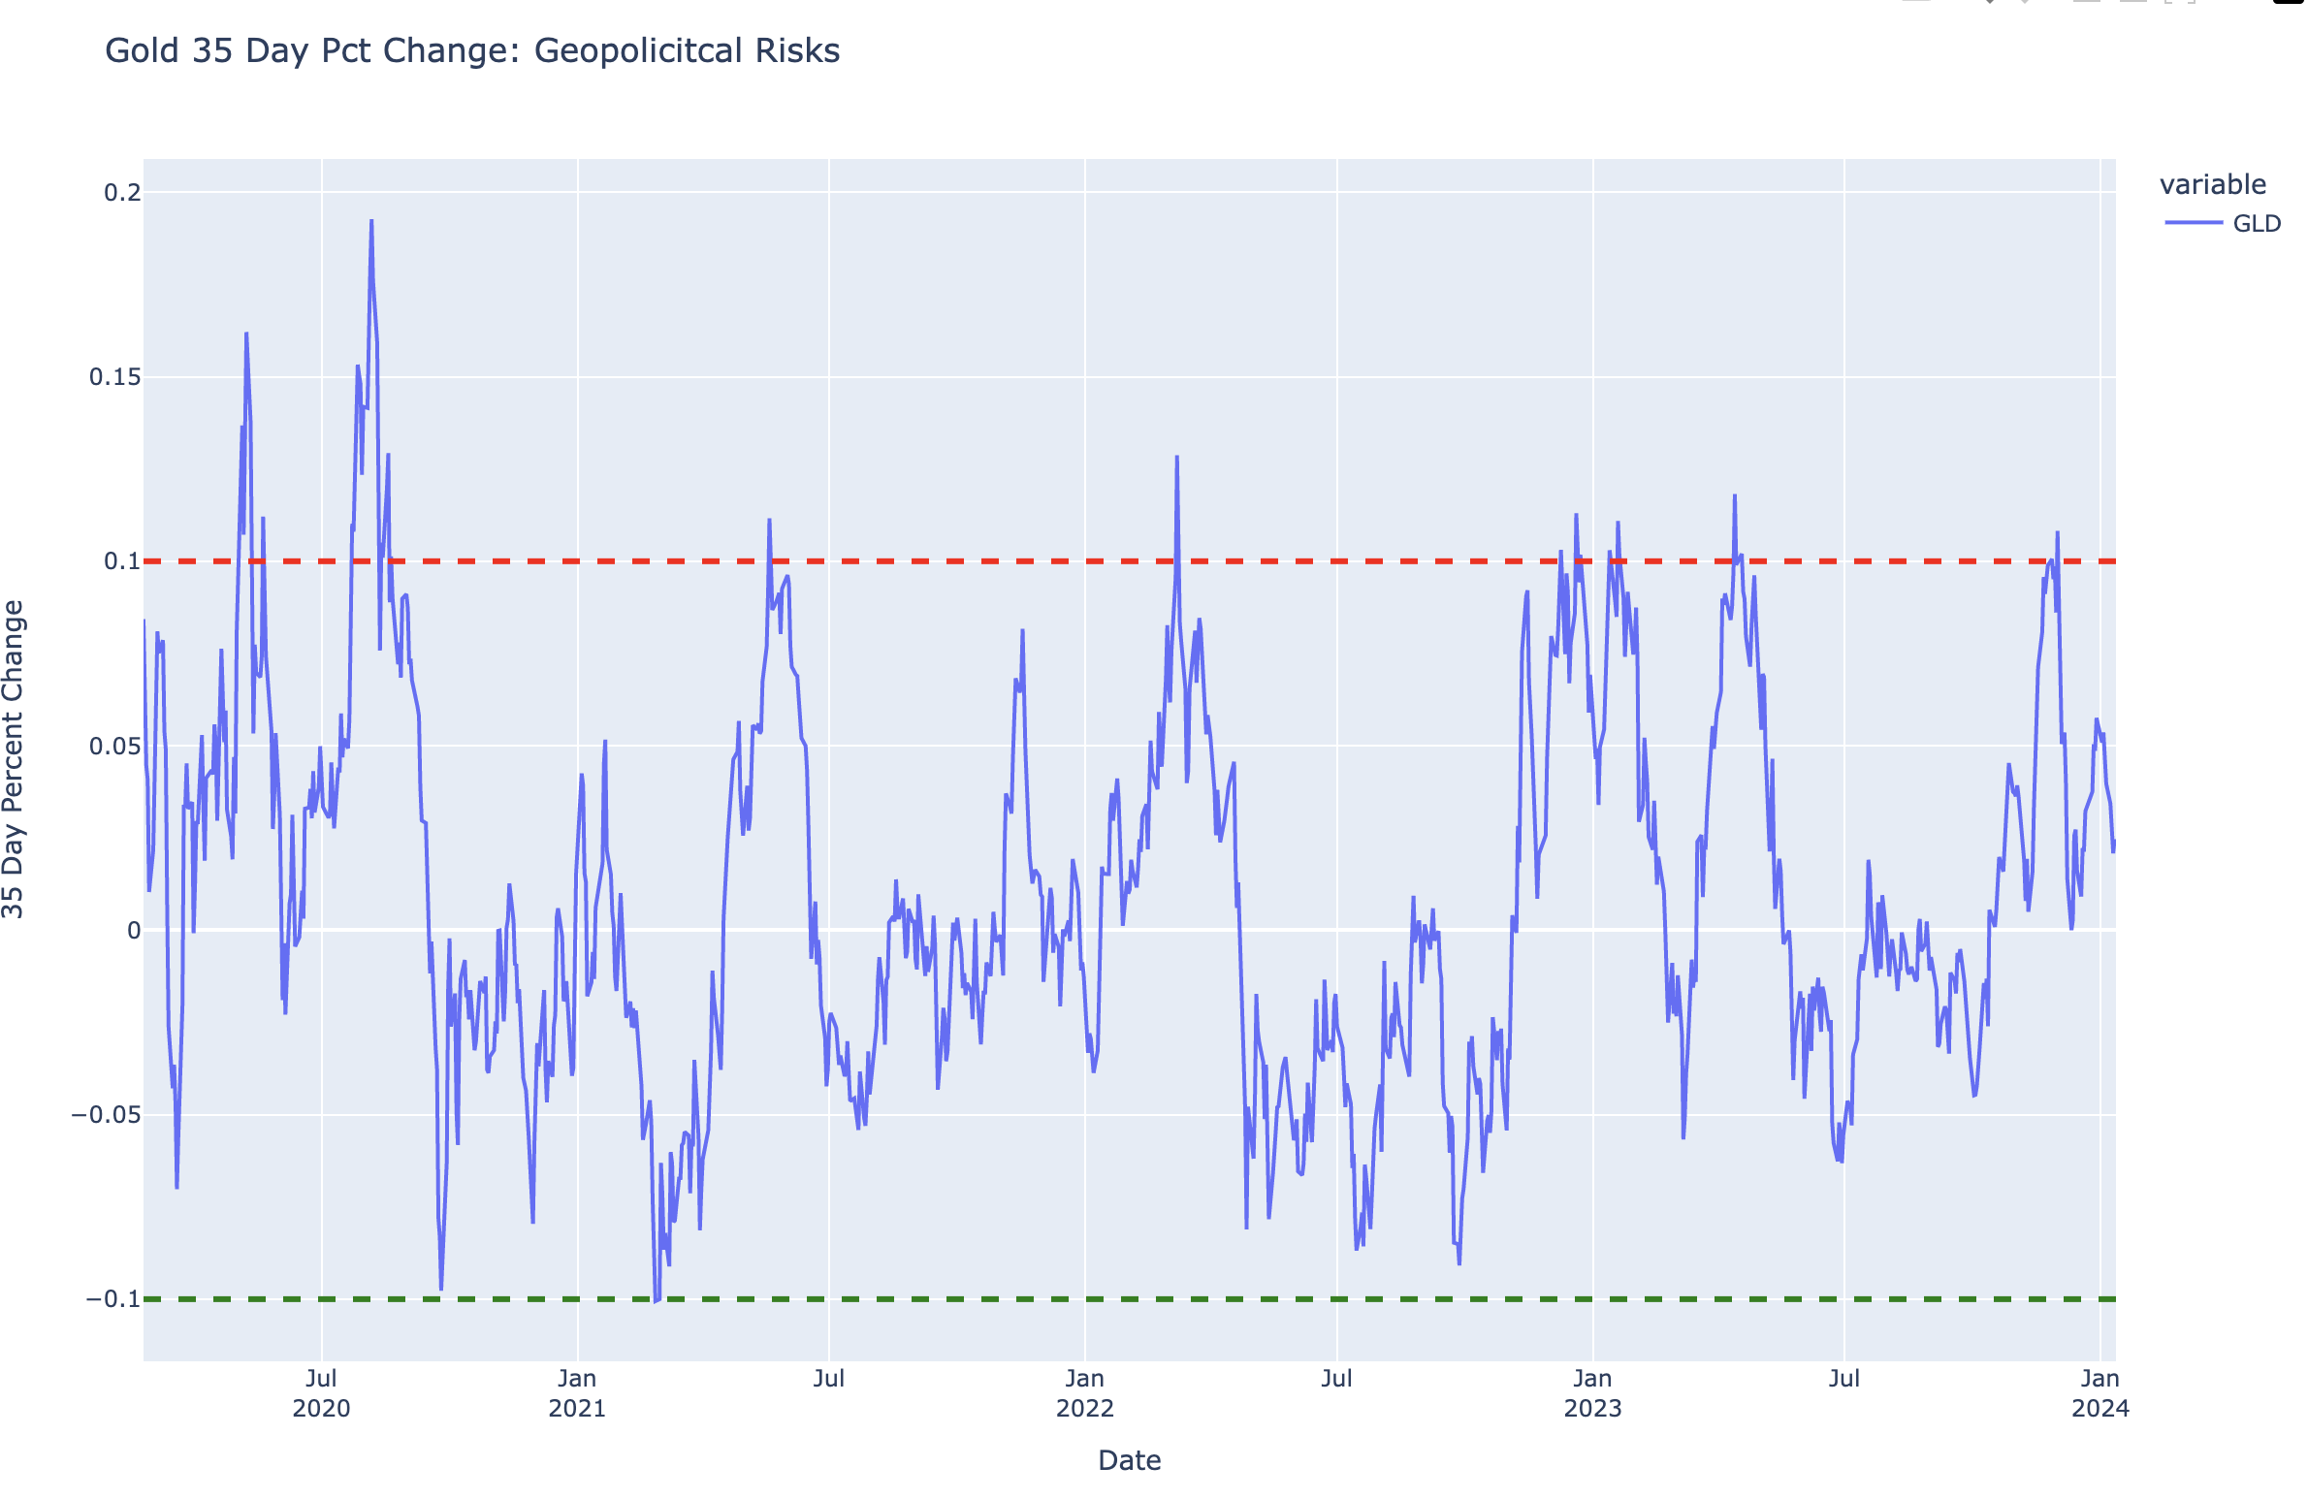
Gold
Geopolitical strife
Hedge against geopolitical uncertainty
Tends to outperform as Real GDP YoY contracts

Slide 23
Appendix / Code
Some of the code used in this deck:
https://github.com/RyanFineganTradingProjects/MacroOutlook2024/blob/main/Macro%20and%20Asset%20Allocation.ipynb
Most of code above was macro stuff I was playing around with
Should be easy to replicate as long as you install all packages listed at beginning of Jupyter Notebook.
Can share code: Most of other sampled work located here
https://github.com/RyanFineganTradingProjects/2023-11-27-Trades
More idiosyncratic, but shows some macro points

